Slide 1

Speak Fluently & Confidently A2- Course 1

Slide 2
Session 2- Talking about Family
Part 1-: My English Family ( Listening)
Part 2: What would you say in the following
situations? ( More Idioms & collocations)
Part 3: Speaking Practice
https://befluent.me/

Slide 3
Session 2- Talking about Family
Part 1-: My English Family
( Listening )
https://befluent.me/

Slide 4
Script:
Todd: So, Katie, let's talk about family.
Katie: Okay.
Todd: In your family, who is nice?
Katie: In my family, I think my, my mum is really nice. She's always looking out for everyone. She always makes sure everybody is happy. And she's just really nice and kind.
Todd: Wow! That's great. Who is a funny person? Who is very funny?
Katie: I think in my family; my dad is very funny. But I don't think he knows he's very funny.
Todd: Alright. Oh, that's interesting. Now who is serious? Is anybody serious?
Katie: I don't think anybody is serious in my family.
Todd: No uncles or aunts?
Katie: Everyone likes to have a laugh. Everyone likes to have a good time.

Slide 5
Script:
Katie: Everyone is always joking.
Todd: Oh, what I nice family.
Katie: (laughs)
Todd: OK. Who is very hardworking?
Katie: Ooohh. Well obviously, my mum is very hardworking. And she's always been very hardworking. She has to make sure that the whole family knows what they're doing. She has to make sure the whole family is ready for every day. Yeah, I think my mum is the hardworking one.
Todd: OK. Is anybody not hardworking? Maybe a little lazy?
Katie: Definitely me. (laughs) Definitely me especially when I was younger. I would never help with any of the chores in the house. I was the lazy one.
Todd: Oh, I understand, I'm the same way. OK. Now in your family, who is very smart?
Katie: My brother is really, really smart. He actually went to Oxford University.
Todd: Whoa.

Slide 6
Script:
Katie: Yeah, he's very smart. But I didn't get any of that. My brother has all the smart genes.
Todd: Wow, that's a good school. OK. Who is very fit?
Katie: Hmm... Well, my dad is a chef and…
Todd: Oh, really?
Katie: Yeah. My dad makes really, really good food, so no one in my family is fit. We all eat too much food.
Todd: Oh, nobody exercises a lot?
Katie: Not really.
Todd: Oh, okay. Yeah, in my family, my dad is super fit.
Katie: (laugh)
Todd: OK. In your family, who is talkative?
Katie: Oh, I keep saying my mum for all of these but my mum is definitely the most talkative. She talks to anybody who - even people who she doesn't know. She will talk to anybody, strangers on the street, people she meets at the bus stop. She talks to everybody.

Slide 7
Script:
Todd: Oh, that's cool. Now, who is quiet?
Katie: Hmm, I think when he's meeting people for the first time, my brother is very quiet. He's very shy. He doesn't like speaking to new people a lot.
Todd: OK. Thanks a lot. Sounds like a nice family.
Katie: Yeah. I think so too.

Slide 10
Vocabulary Quiz
l
looking out for • obviously • chores gene • fit • strangers
He runs every day. He is very .
My dad is always out for me.
He is not happy. He looks mad.
You can meet when you travel.
He has the smart in the family.
I did not finish all my .

Slide 11
Vocabulary Quiz Answers
looking out for • obviously • chores gene • fit • strangers
He runs every day. He is very fit .
My dad is always looking out for me.
He is obviously not happy. He looks mad.
You can meet strangers when you travel.
He has the smart gene in the family.
I did not finish all my chores .

Slide 14
Session 2- Talking about Family
Part 2: What would you say in the following
situations? ( More Idioms & collocations)
https://befluent.me/

Slide 15
Session 2- Talking about Family
Like Father, Like Son
Meaning: Sons inherit their fathers’ traits and preferences, often even without realizing it.
Example: John was a great fisherman. His son Matt is aalso a great fisherman. Like father, like son.
Run in the Family
Meaning: Be inherited (as a trait) by multiple members of a family
Example: I’m not surprised Maria has started playing in a band. Musical talent runs in her family.
One Big Happy Family
Meaning: A group of people who live or work together and are very close
Family Man
Meaning: A man devoted to taking care of his wife and children
A Helicopter Parent
Meaning: a parent who overprotects and overcontrols their children, hovering around like a helicopter and monitoring everything that the children.
Example: His mum was a real helicopter parent and sent instructions to the kitchen on how to cook her son’s rice for every meal.
https://befluent.me/

Slide 16
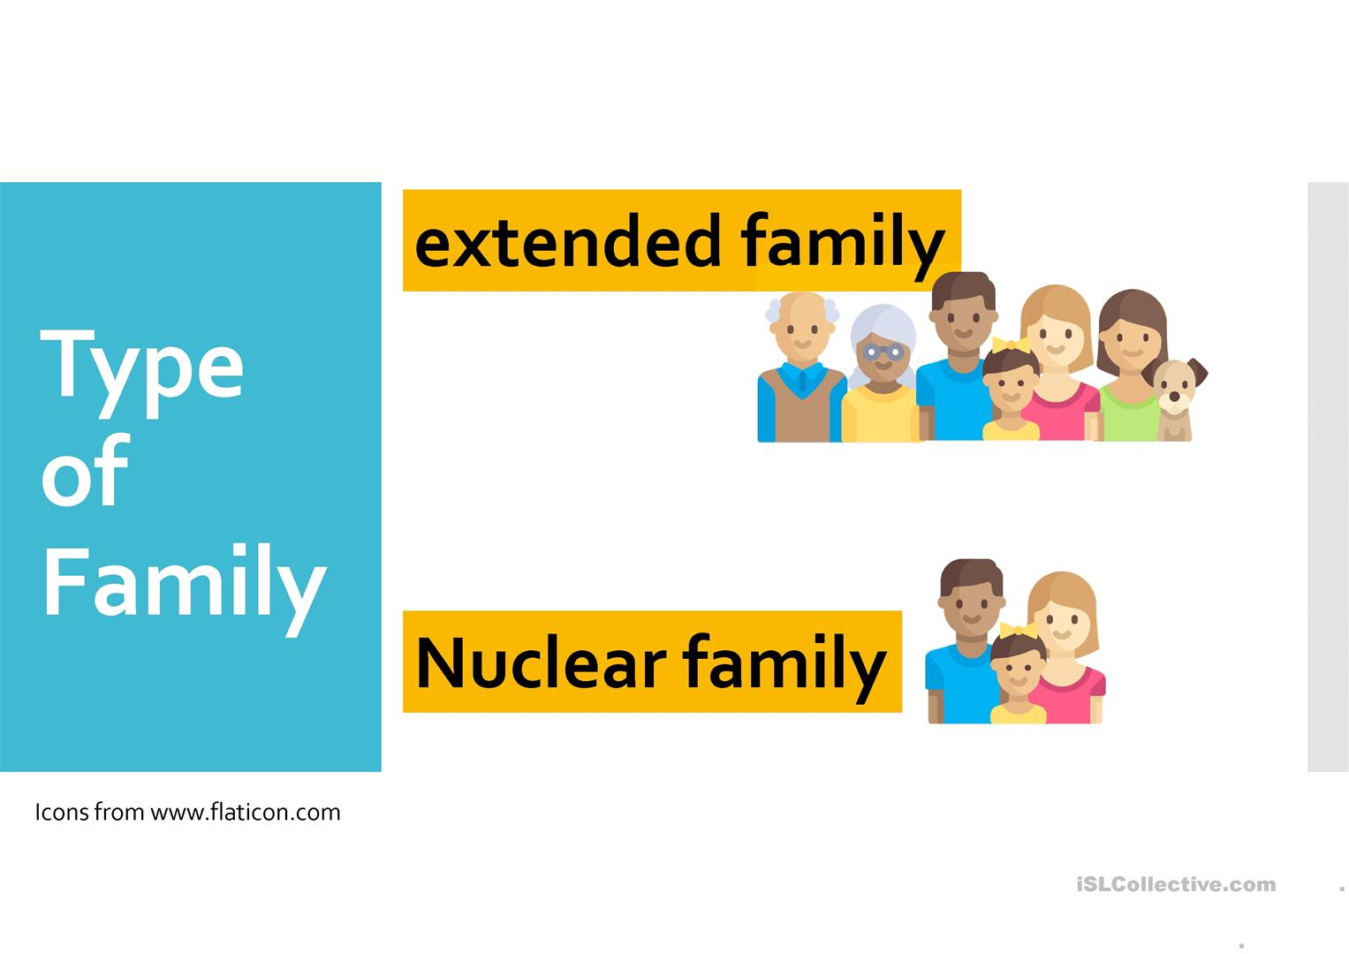
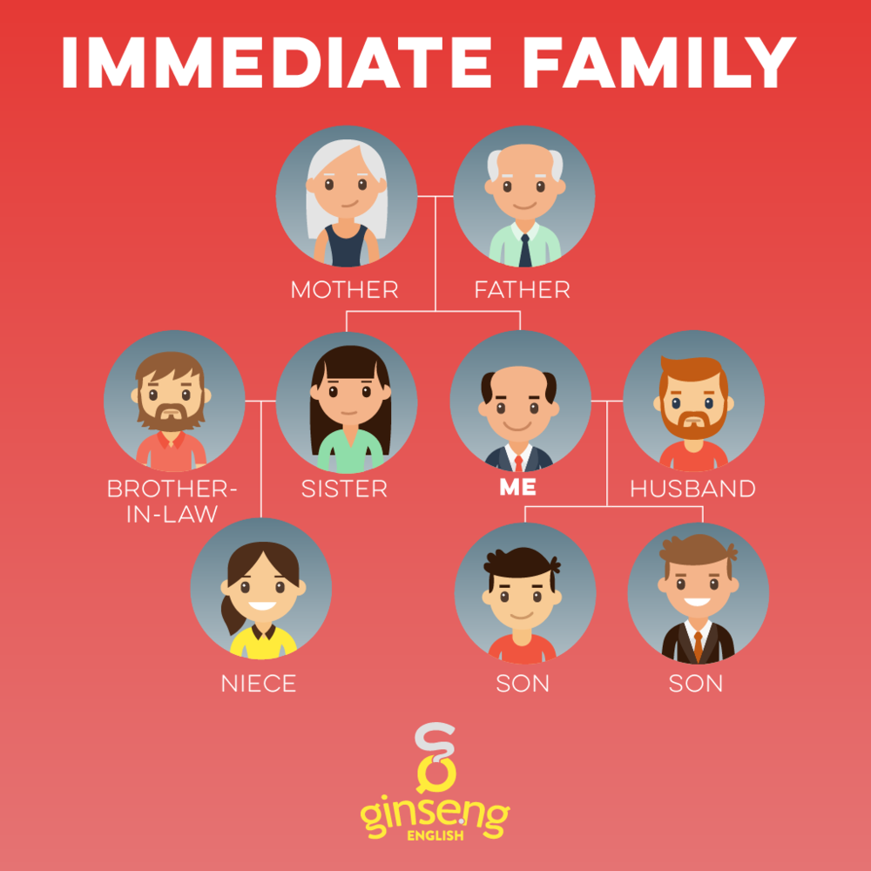
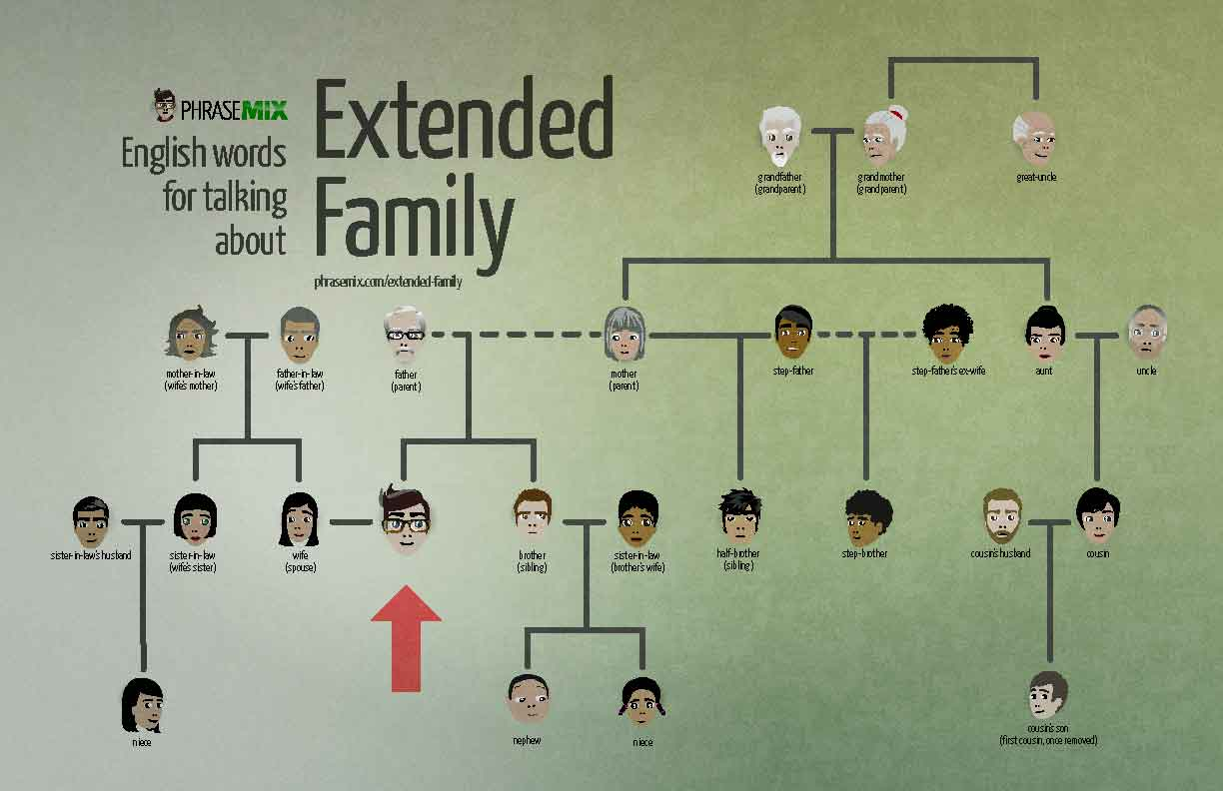
Session 2- Talking about Family
= Nuclear Family
= Immediate Family
https://befluent.me/

Slide 17
Session 2- Talking about Family
Part 3: Speaking Practice
https://befluent.me/

Slide 18
Session 2- Talking about Family
(Like Father, Like Son -Run in the Family- One Big Happy Family -Family Man- A Helicopter Parent)
Answer the following questions using some of the above idioms:
Tell me about your family.
Student : My family contents About my parent and one sister and my 2 brother.
Correction: My immediate family is made up of my parents, one sister and 2 brothers. My son is very talkative and he likes painting. Like father, like son. He doesn’t like to wake up early and he likes math like addition and subtraction and he doesn’t like to eat vegetables. It runs in the family. I am a helicopter parent.
Do you have a big family? / Would you like to have a big or a small family?
Student : Yes, I have a big family. My eldest son likes fruits .. Like father like son and my daughter likes watching Sci-fi/ science fiction movies and my smallest son likes technology. It runs in the family.
Correction: youngest
Are friends more important than family? What do you think?
Student : no, friends are not more important than family. / absolutely not. I always need them.
Correction: Absolutely,not because / coz I always need my family. They always support me. They always help me to do anything. But friends are also important but not more important than
Family.
What do you think of assigning chores to children in the family?
Student :
Correction:
https://befluent.me/

Slide 19
Session 2- Talking about Family
(Like Father, Like Son -Run in the Family- One Big Happy Family -Family Man- A Helicopter Parent)
Answer the following questions using some of the above idioms:
What do you like doing when you spend time with your family?
Student :
Correction:
Did you ever meet any of your great grandparents?
Student :
Correction:
How did you get your name? Who are you named after?
Student :
Correction:
What is the most important thing your parents taught you?
Student :
Correction:
https://befluent.me/

Slide 20
Session 2- Talking about Family
(Like Father, Like Son -Run in the Family- One Big Happy Family -Family Man- A Helicopter Parent)
Answer the following questions using some of the above idioms:
If you could have a different number of siblings and children, what would it be? Why?
Student :
Correction:
If you were offered an excellent job opportunity abroad, would you consider leaving your family for an indefinite period of time?
Student :
Correction:
https://befluent.me/

Slide 21
Session 2- Talking about Family
(Like Father, Like Son -Run in the Family- One Big Happy Family -Family Man- A Helicopter Parent)
There is much talk recently of increased social problems due to family breakdown. Is this true?
Student :
Correction:
Do you ever get tired of family duties?
Student :
Correction:
Do you consider close friends as family? Explain why?
Student :
Correction:
https://befluent.me/

Slide 22

Session 2- Talking about Family
(Like Father, Like Son -Run in the Family- One Big Happy Family -Family Man- A Helicopter Parent)
Do you like taking photos with your family?
Student :
Correction:
Can you describe this picture?
Student : This happy family is made up of a grandfather,
A grandmother, a wife, a husband, a daughter and a son.
They talking all of them.
Correction: They are talking together and they are smiling
They are happy and they are having a good time.
https://befluent.me/

Slide 23
Session 1- Likes & Dislikes
Supplementary Material
https://befluent.me/

Slide 24
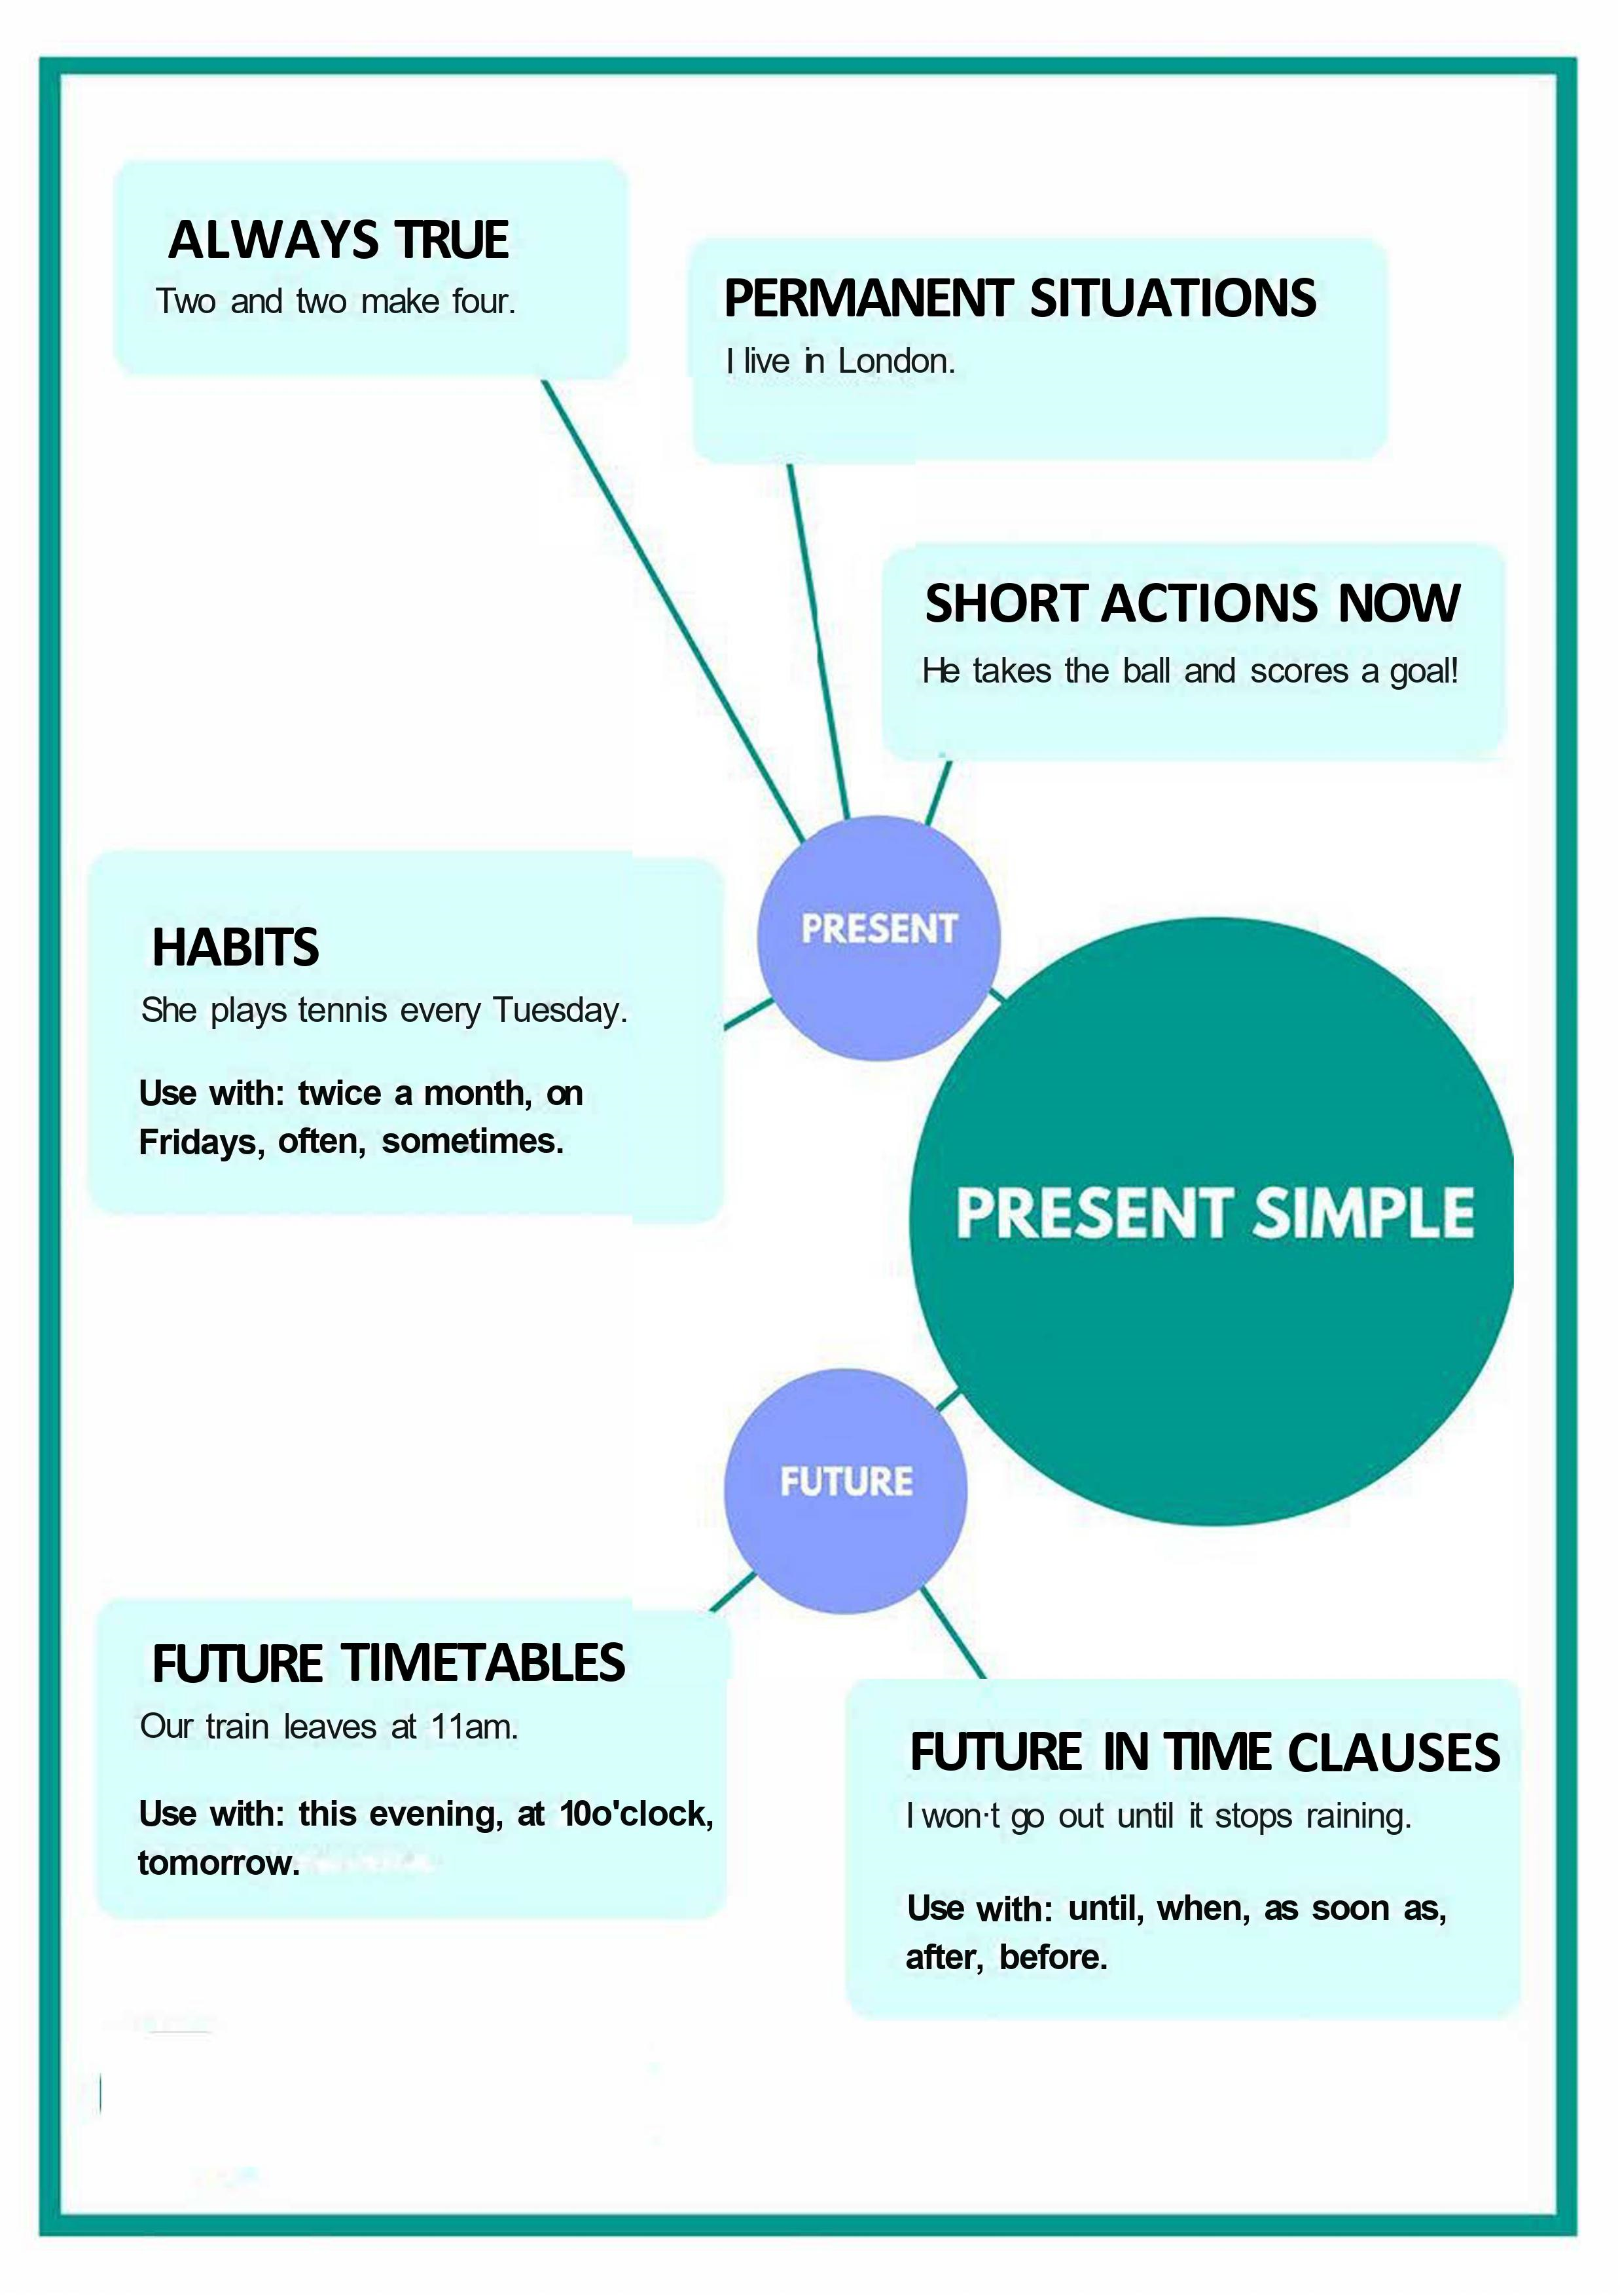
Session 1- Likes & Dislikes
https://befluent.me/

Slide 25
Session 1- Likes & Dislikes
When to use the Present simple tense- Function:
1: We use the present simple when something is generally or always true.
People need food.
It snows in winter here.
Two and two make four.
2: Similarly, we need to use this tense for a situation that we think is more or less permanent.
Where do you live?
She works in a bank.
I don't like mushrooms.
3: The next use is for habits or things that we do regularly. We often use adverbs of frequency (such as 'often', 'always' and 'sometimes') in this case, as well as expressions like 'every Sunday' or 'twice a month’.
Do you smoke?
I play tennis every Tuesday.
I don't travel very often.
https://befluent.me/

Slide 26
Session 1- Likes & Dislikes
When to use the Present simple tense- Function:
4: We can also use the present simple for short actions that are happening now. The actions are so short that they are finished almost as soon as you've said the sentence. This is often used with sports commentary.He takes the ball, he runs down the wing, and he scores!
Future Uses
5: We use the present simple to talk about the future when we are discussing a timetable or a fixed plan. Usually, the timetable is fixed by an organization, not by us.
School begins at nine tomorrow.
What time does the film start?
The plane doesn't arrive at seven. It arrives at seven thirty.
https://befluent.me/

Slide 27
Session 1- Likes & Dislikes
When to use the Present simple tense- Function:
6: We also use the present simple to talk about the future after words like ' 'when', 'until', 'after', 'before' and 'as soon as'. These are sometimes called subordinate clauses of time.
I will call you when I have time. (Not 'will have'.)
I won't go out until it stops raining.
I'm going to make dinner after I watch the news.
Conditional Uses 7: We use the present simple in the first and the zero conditionals.
If it rains, we won't come.
If you heat water to 100 degrees, it boils.
https://befluent.me/

Slide 28
Make the present simple, positive, negative or question:
I _________________ (be) in a café now.
2. _________________ (she / play) tennis every week?
3. They _________________ (go) to the cinema every Wednesday.
4. _________________ (she / be) a singer?
5. You _________________ (find) the weather here cold?
6. _________________ (they / be) on the bus?
7. Lucy _________________ (ride) her bicycle to work.
8. Why _________________ (he / be) in France?
9. I _________________ (not / play) the piano often.
10. It _________________ (not / be) cold today.
11. We _________________ (be) from Portugal.
12. _________________ (we / make) too much noise at night?
13. Where _________________ (Harry / study)?
14. _________________ (it / be) foggy today?
15. We _________________ (not / be) late.
16. They _________________ (not / like) animals.
17. Where _________________ (you / be)?
18. He _________________ (not / be) an accountant.
19. _________________ (the dog / eat) chicken?
20. She _________________ (be) my sister.

Slide 29
Session 2- Talking about Family
Thank you!☺
https://befluent.me/

